Slide 1
Robust Slam
Michael Willett

Slide 2
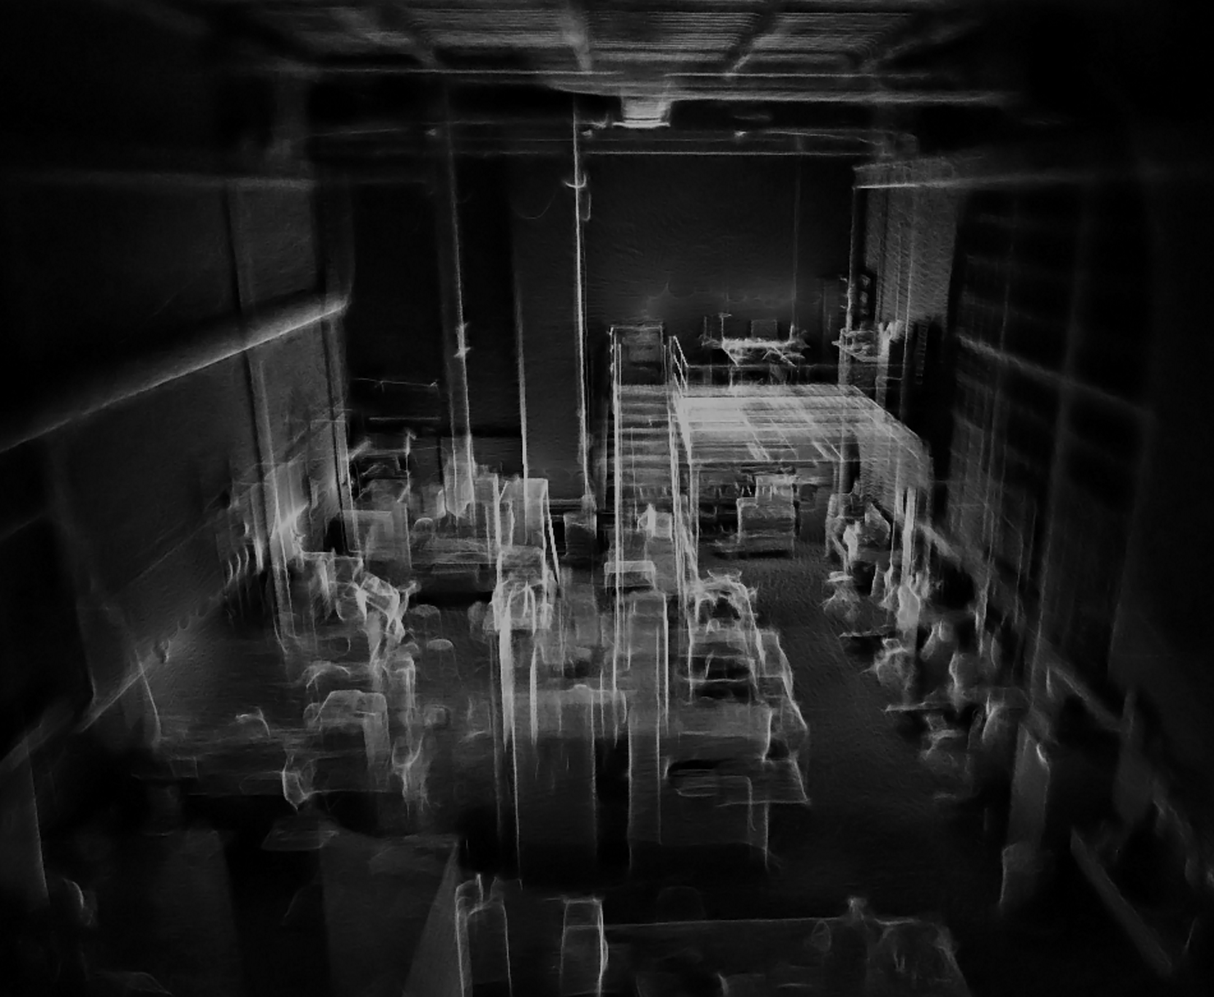
What is SLAM?
Simultaneous Localization and Mapping
If the true sensor position and orientation is known, mapping is a simple process of inserting obstacles according to the sensor reading for that position.
If the map is known, sensor position can be inferred using a number of different error minimization techniques.
SLAM solves the problem when neither the map or sensor position are known

Slide 3
SLAM Algorithm with Point Clouds
Generate a random set of possible sensor position.
Find the particle that best aligns with current map.
Update the map assuming the sensor is at that particle state (use Least Squares for small adjustments)
Resample the particles proportionally to their weight distribution.
Repeat steps 1 through 4 for each successive sensor input.
Sensor Alignment Metric:
Search the point cloud for the nearest recorded point relative to the sensor prediction
Point cloud is stored in KD-tree for fast nearest-neighbor search
Weighted regression helps with imperfect alignment with map

Slide 4
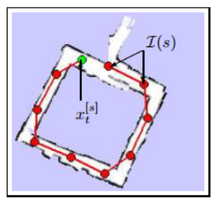
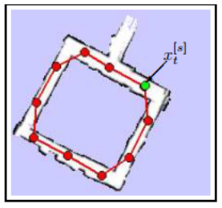
Active Loop Closure
Incremental errors in position predictions add up over time.
If the sensor detects previously recorded data, the entire map can be updated to perform proper loop closure.
Most common methods record sensor path as a digraph on top of the map being built.

Slide 5
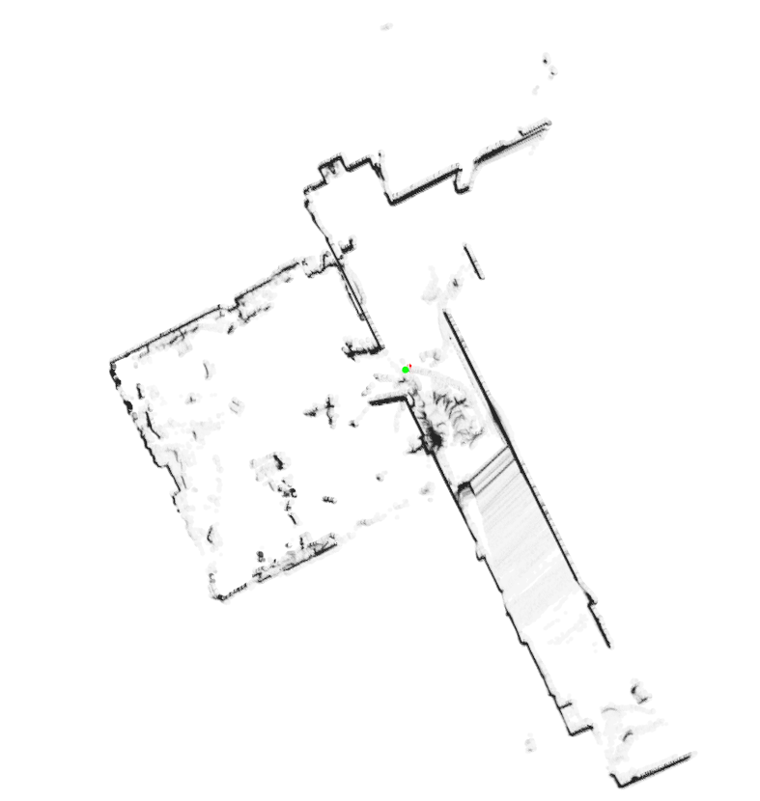
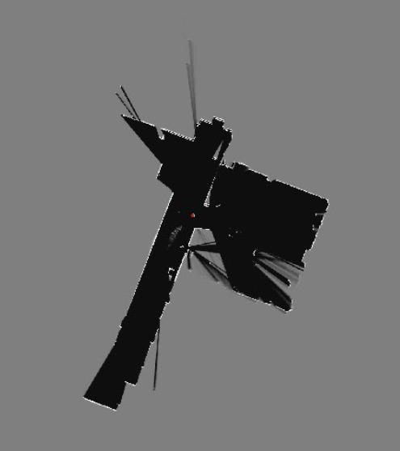
Results

Slide 6
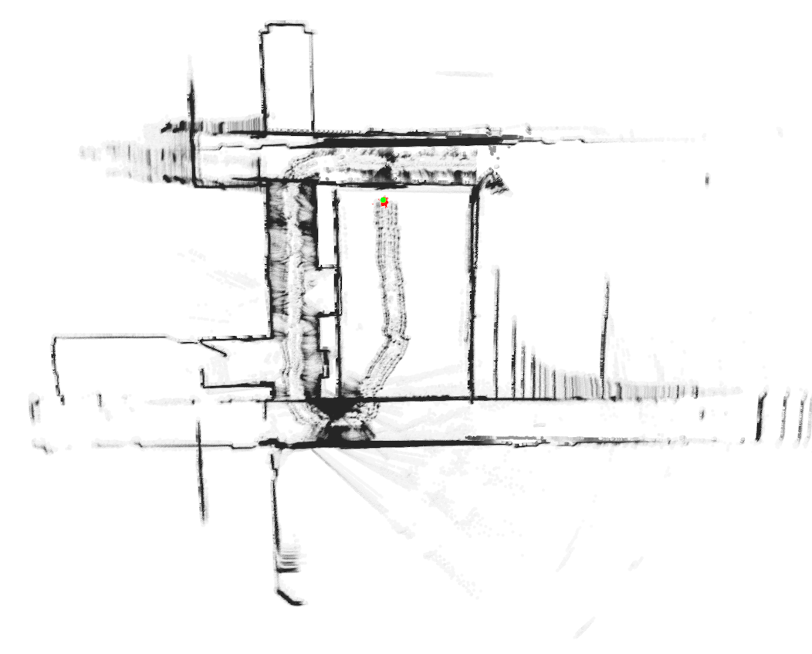
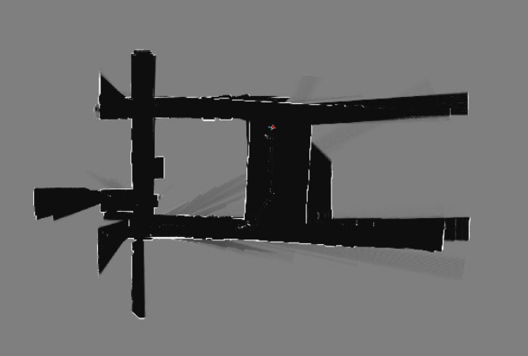
Results

Slide 7
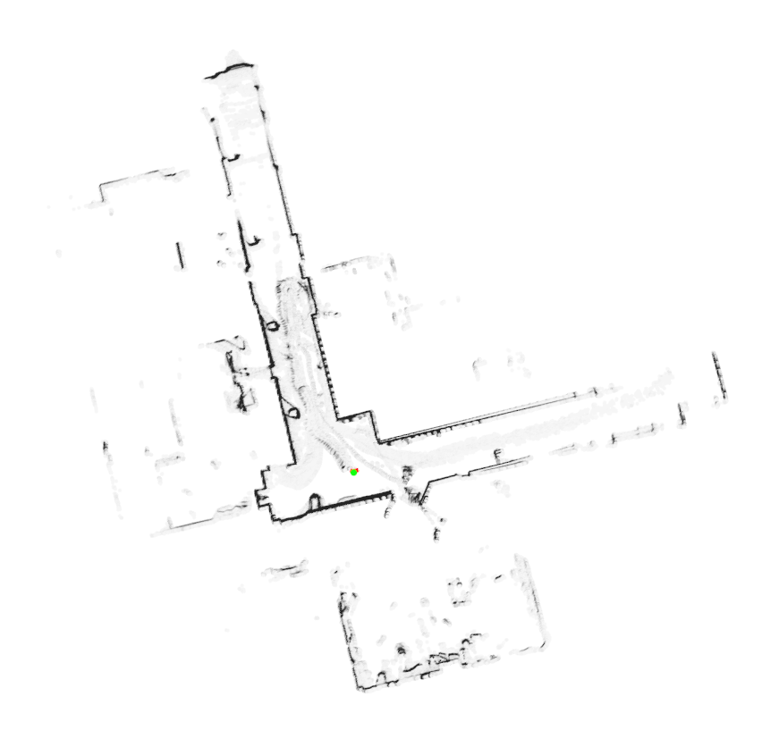
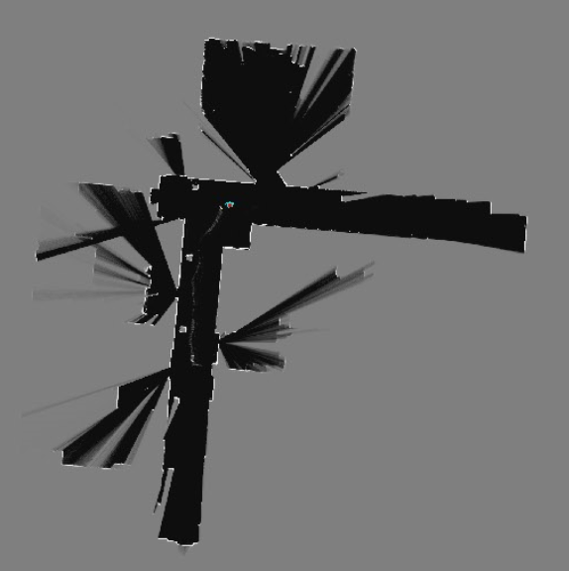
Results

Slide 8
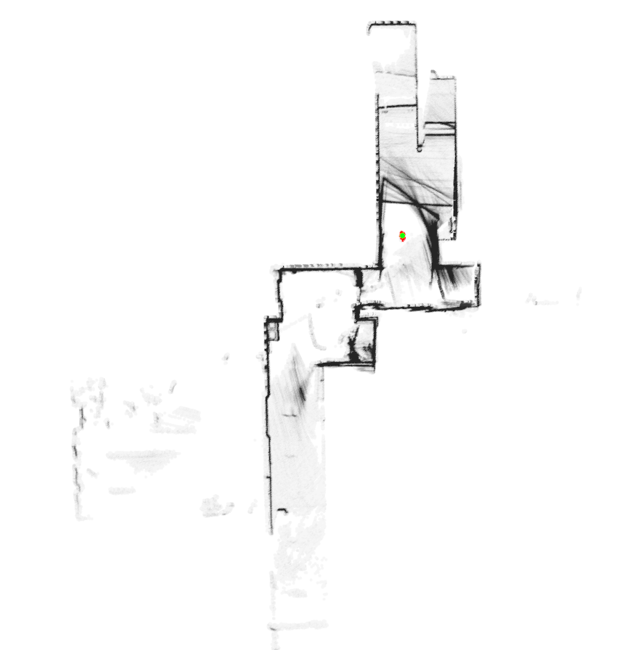
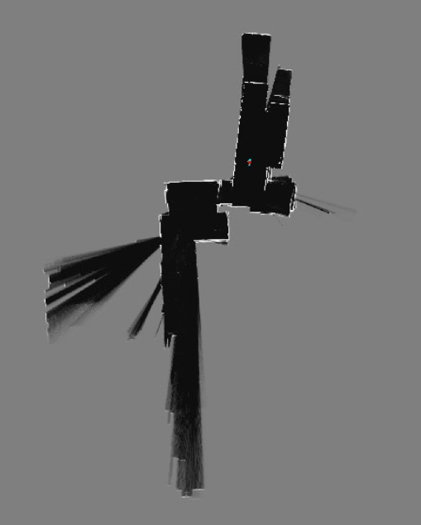
Results

Slide 9
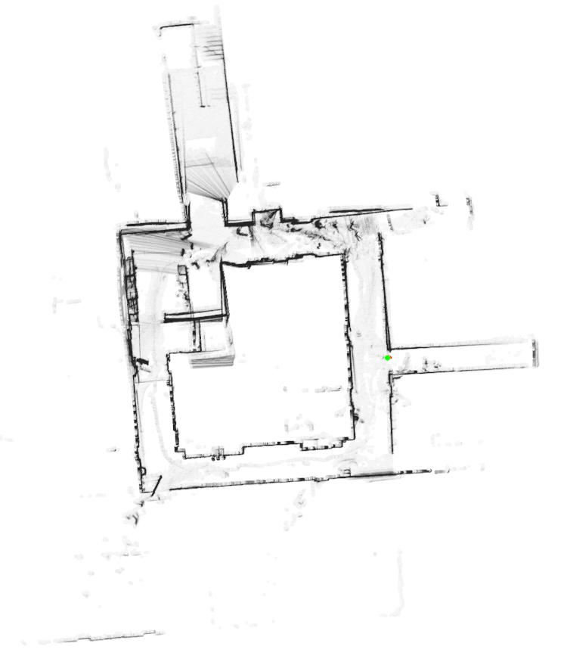
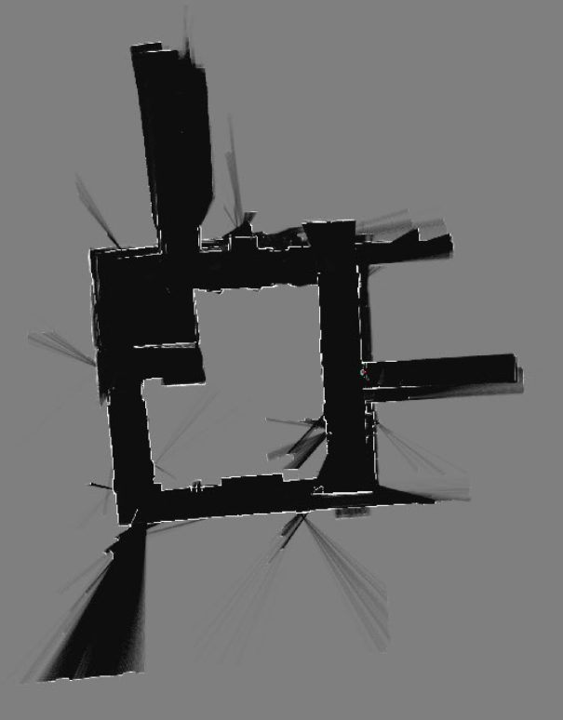
Results

Slide 10
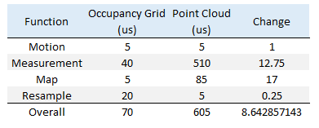
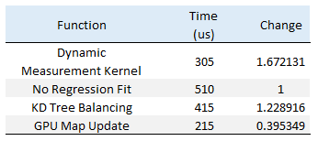
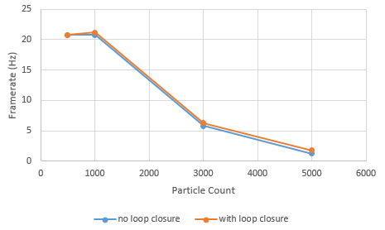
Performance
Particle count had significant effect on Occupancy Grid approach, adding regression allows for significantly reducing particles without loss of accuracy
Map Updates are slow. Potentially these do not need to run every iteration, and should be in batches.
Searching the entire KD tree is slow. Maintaining multiple trees at topology nodes should improve search speed.

Slide 11
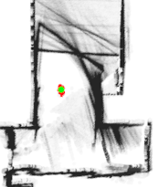
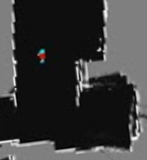
Shortcomings
Current implementation does not remove sensor noise appropriately, leading the algorithm to get stuck in hallways without obvious sensor features.
KD-Tree search is slow. Dynamic Parallelism improves performance, but still does not run real time. Uniform Grid structure may be faster.
More accurate regression model using non-linear regression, SIFT features, and others.

Slide 12
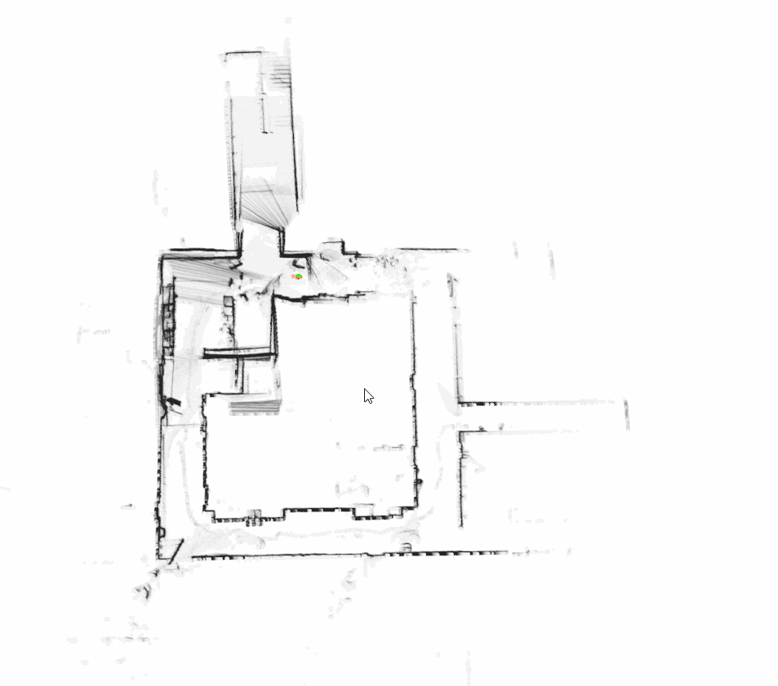
Point Cloud SLAM - Demo

